Slide 1
Step-by-Step Guide to Bulk Importing

Slide 2
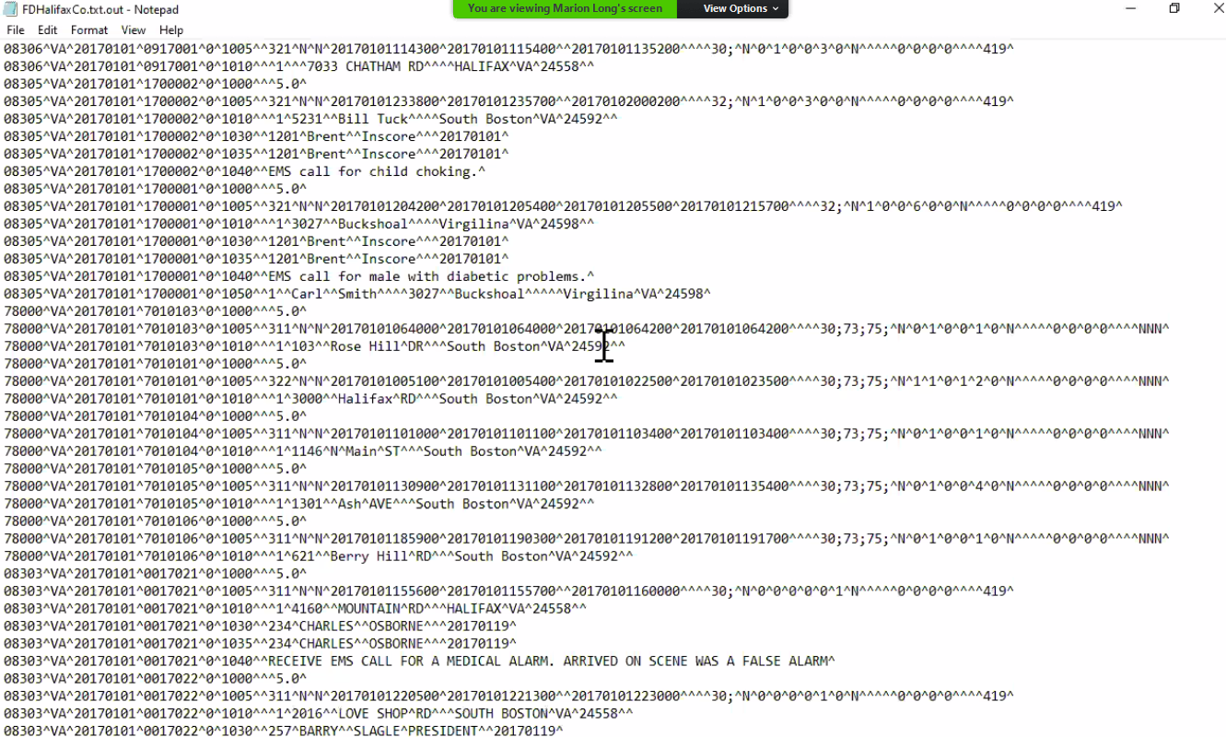
1. NFRIS Import File
Must be an NFRIS delimited transaction
Formats: Text (ANSI), Text (UTF-8), or Zipped
Browsers: IE, Edge
Email aghorley@oci.ga.gov for more information on how to create your text file.

Slide 3
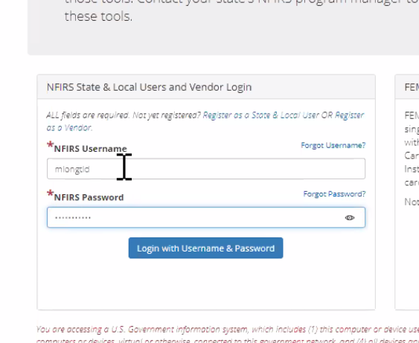
2. Login to eNFRIS
Permissions-based: to use the import incident utility, the user must have the correct incident/FD and the Bulk Import permission.
Link to new webpage will be sent once upload is complete.

Slide 4
3.View of Profile inside eNFRIS
Multiple Fire Departments
If you are working for multiple fire departments, all departments will be listed on this page. Insure you select the correct department. If the file is uploaded in the wrong department it will be rejected.

Slide 5
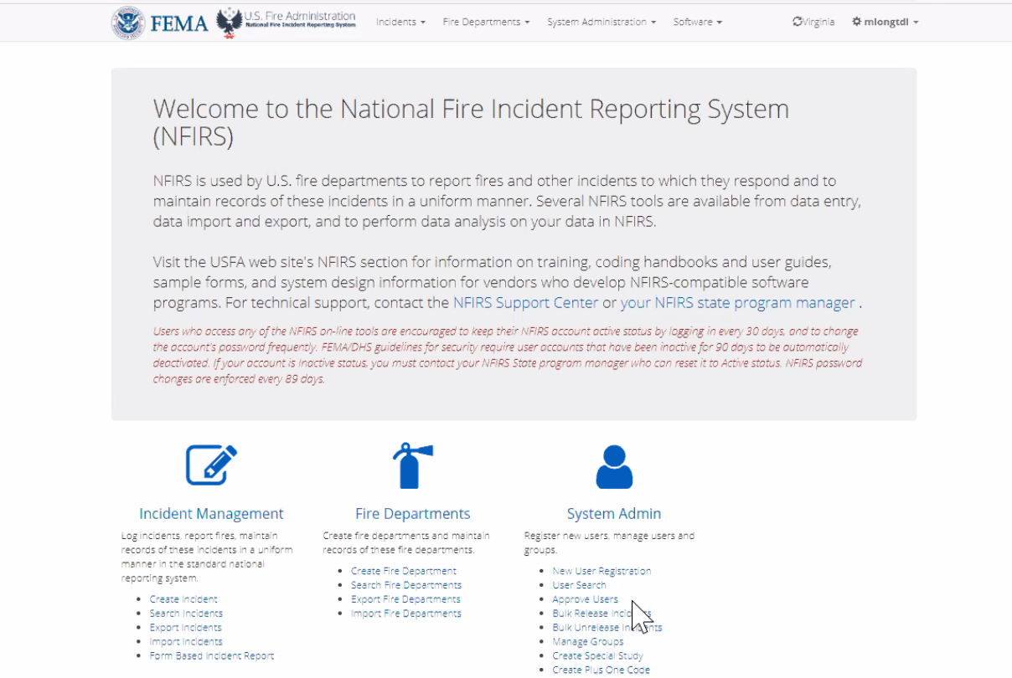
4. On Main Screen Inside eNIFRIS, Select “Import Incidents”

Slide 6
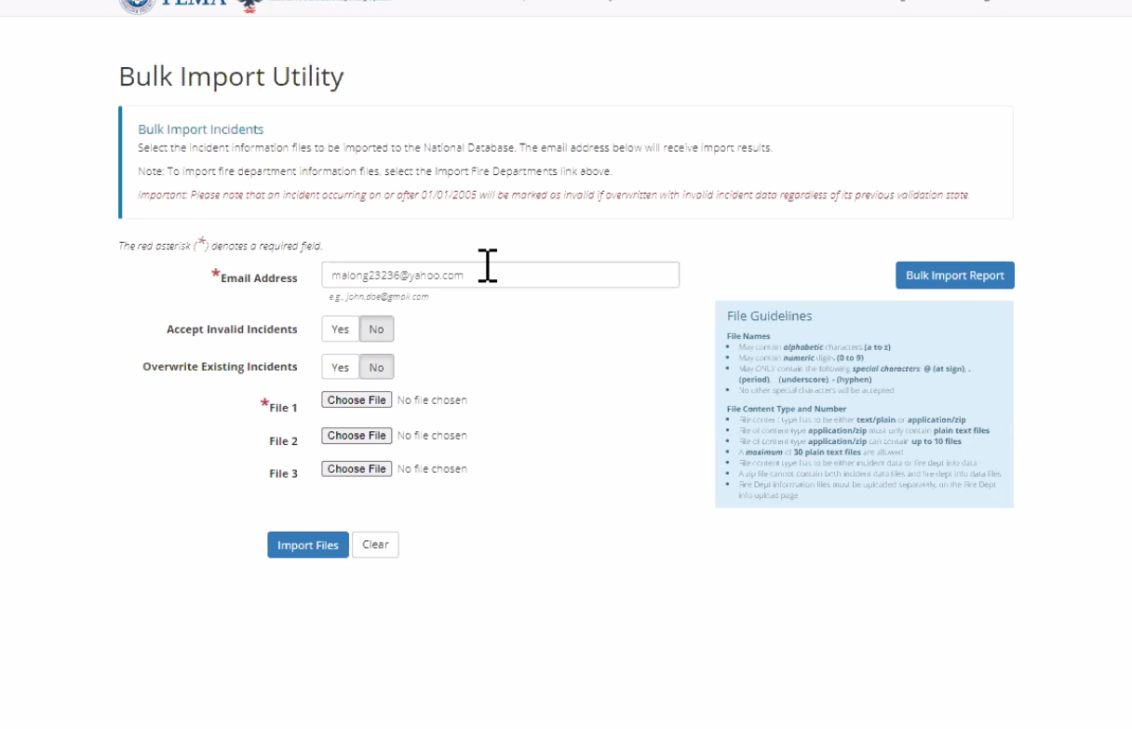
6. Prompt Page (Inputting Files to Upload)
It is very important that you have the correct email listed in this section, as you will receive all notifications through the inputted email.
Accept “Invalid Incidents” and “Overwrite Existing Incidents” (always choose yes for these options)
Choose File- Can upload 3 text files at a time or up to 10 files within a zip file at a time.
Once uploaded, choose “Import Files.”

Slide 7
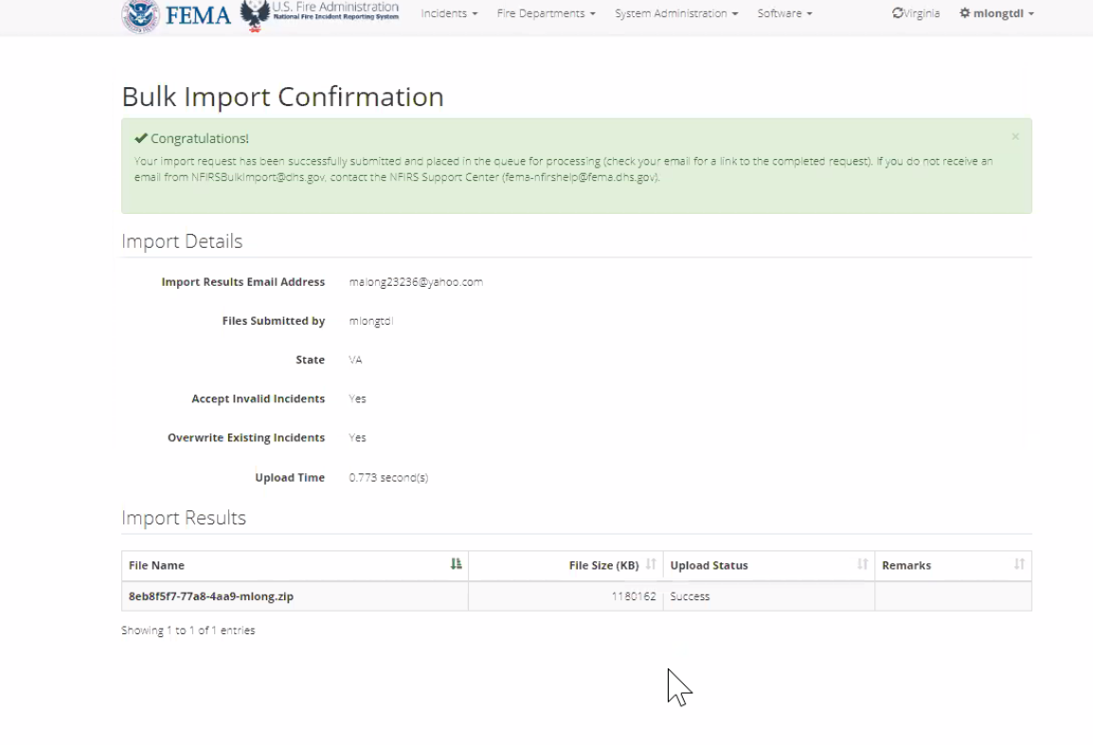
7. Screen That Appears After All Files Have Been Inputted Into the System
Submitting a job just means it is in the queue waiting to process. You will receive a confirmation email once the process is complete.

Slide 8
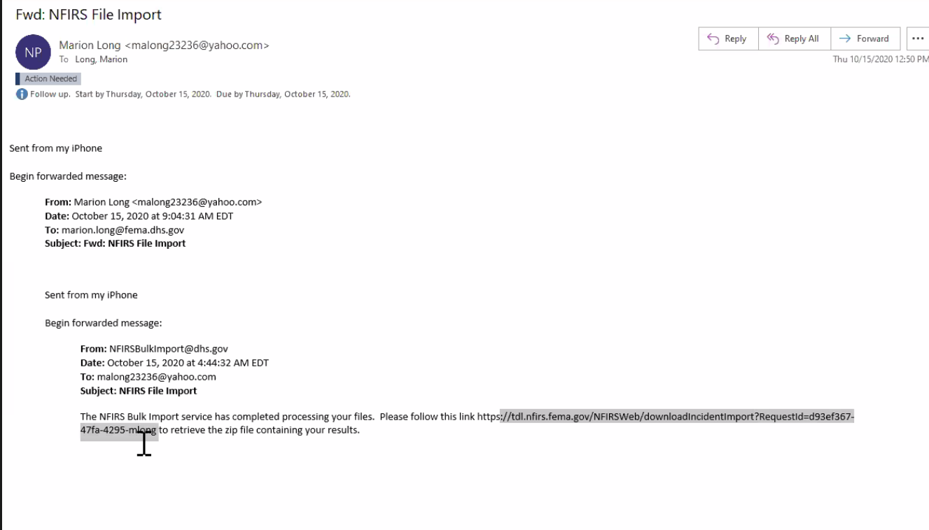
8. Email Will be Received Once Uploaded. This Email Will Advise if There Were Errors.
To view errors click link listed in email.

Slide 9
9. After Selecting the Link, a Box Will Appear in the Bottom of Your Screen. Click “Save.”

Slide 10
10. Types of Files That Will be Received in the Email
.TXT – Incident Validation
.ERR – Critical Incidents, Warning Incidents
.BAD – Contains the import transaction records of only those incidents with critical and warning errors.
.OUT Contains the import transaction records of all incidents.
Parsing file
NFRIS 4.1 reference (Disregard this file)

Slide 11
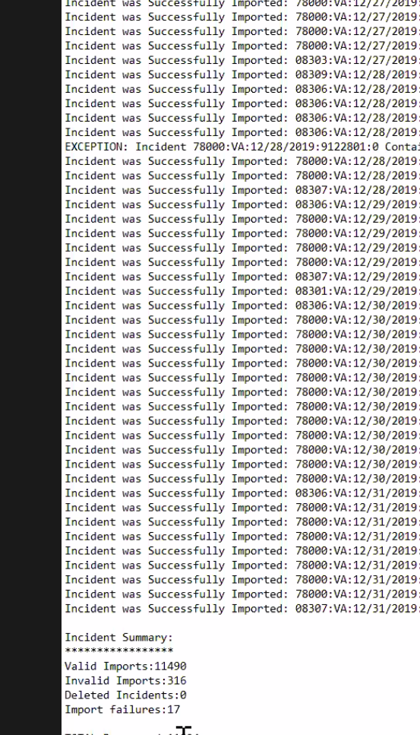
10..LOG is the Most Important File to Review
At the bottom of the file will be a section that includes how many incidents were valid, invalid, deleted, and any failures that were in the upload.

Slide 12
11. How to Make the .ERR File Easier to Read
Open Excel
Select Open
Select Browse
Change all excel files to all files
Location/Select the .ERR file
Select Open
Text import wizard, Step 1 of 3
Set data type to delimited
Select Next
8. Text Import Wizard, Step 2 and 3
1. Select the file’s delimiter
Tab
Other, ^
Other, I
9. Text Import Wizard, Step 3 of 3 (Data Preview)
Chg. Col. 1 (FDID) to Text.
Chg. Col. 3 (Inc. Data) Date: MDY
Chg. Col. 4 (Inc. No.) to Text.
Chg. Col. 5 (Exposure) to Text.
Select Finish

Slide 13
11. How to Make the .ERR File Easier to Read (Continued)
Format Worksheet
Resize Columns
Insert Row Above Row #1
Label Columns in the blank, row #1, e.g.,
FDID
STATE
DATE
INC NO.
EXP.
MODULE
ERR MSG.
ERR TYPE
DATA FIELD
4. Resize Columns
5. Freeze Panes
Select cell E2
Select View
Select Freeze Panes
Select Freeze Panes
6. Filter Columns
Select A1
Select Data
Select Filter
7. Save Workbook
When saving change file type to .xlsx

Slide 14
More information will be coming soon. For Questions please call:
Amanda Jones Fire and Life Safety Educator Supervisor of Reporting Office of Commissioner John F. King C: 470.725.5722 ajones@oci.ga.gov

