Slide 1



GEORGIA FIRE INCIDENT REPORTING
NERIS
Gaining Insight into Upcoming NERIS Reporting
GET STARTED

Slide 2


ATTENTION
Training Overview
This training is centered around the State of Georgia's Image Trend Elite Reporting Form, which is part of the State of Georgia Reporting System. If you are using a third-party RMS Reporting system or have acquired a Fire Department Image Trend License through Image Trend Elite, please contact your RMS Vendor for training specific to your system.
All other requirements for Georgia can be found in the Georgia Fire Incident Reporting Guide and Georgia Reporting Scheme.

Slide 3



WHERE IT ALL STARTED
NFIRS to NERIS
NFIRS Begins
NFIRS Update
America Burning, released in 1973, prompted the establishment of the USFA in 1974 under the Federal Fire Prevention and Control Act. Following this, NFIRS was introduced in 1975.
NFIRS Transforms into a Comprehensive All-Hazard Data Collection System
With the inclusion of EMS data, wildfire information, and a juvenile firesetter module, NFIRS evolves into a complete all-hazard data collection system.
1985
2025
Sunsetting NFRIS
NFIRS Released
1975
1999
Due to concerns regarding security, outdated models, and the costs associated with maintaining the code base, NFIRS will sunset at the beginning of the calendar year 2026, and the decommissioning process will commence.
First Public Release of NFIRS Data Collection

Slide 4

WHAT IS NERIS?
The National Emergency Response Information System (NERIS) is a cloud-based platform designed to replace the existing National Fire Incident Reporting System (NFIRS). Its primary objective is to deliver real-time, detailed data on emergency incidents. This empowers fire departments nationwide to make more informed, data-driven decisions regarding preparedness, risk reduction, and training.

Slide 5

WHY IS THIS DATA IMPORTANT?
  Identify Trends and Causes
  Enhance Response Times and Tactics
  Plan Resource Allocation
  Create Prevention Strategies
  Support Budget Justification
  Establish Policies and SOPs
  Foster Understanding Among Constituents

Slide 6

WHAT IMPROVEMENTS WILL NERIS OFFER?
MULTI-HAZARD INCIDENT REPORTING
COMPREHENSIVE REPORTING:
Transition from a single-category system to a model that accommodates up to three types of incidents. This change acknowledges the complexity that fire services frequently encounter in real-world situations.
FOR FIREFIGHTERS
Streamline your reporting by choosing incident types that precisely represent the situation, thereby removing the uncertainty associated with single-category limitations.
FOR CHIEFS/DATA ANALYSTS:
Reduce reliance on interpreting free-text narratives, streamlining data analysis
MULTI INCIDENT TYPES
NFIRS restricted incident type selection to a single category, while NERIS will permit multiple types for each incident.

Slide 7
UPDATES TO ACTIONS, TACTICS AND INCIDENT OUTCOMES
1.
Actions & Tactics
Updated to gather extensive operational data, encompassing suppression techniques, ventilation strategies, and tactics for reducing on-scene contamination.
2.
Rescues, Casualties, and Maydays
Comprehensive Monitoring of Essential Data Highlighting Firefighters' Critical Contributions During Emergency Responses
NERIS Actions and Tactics Flow Chart attached

Slide 8

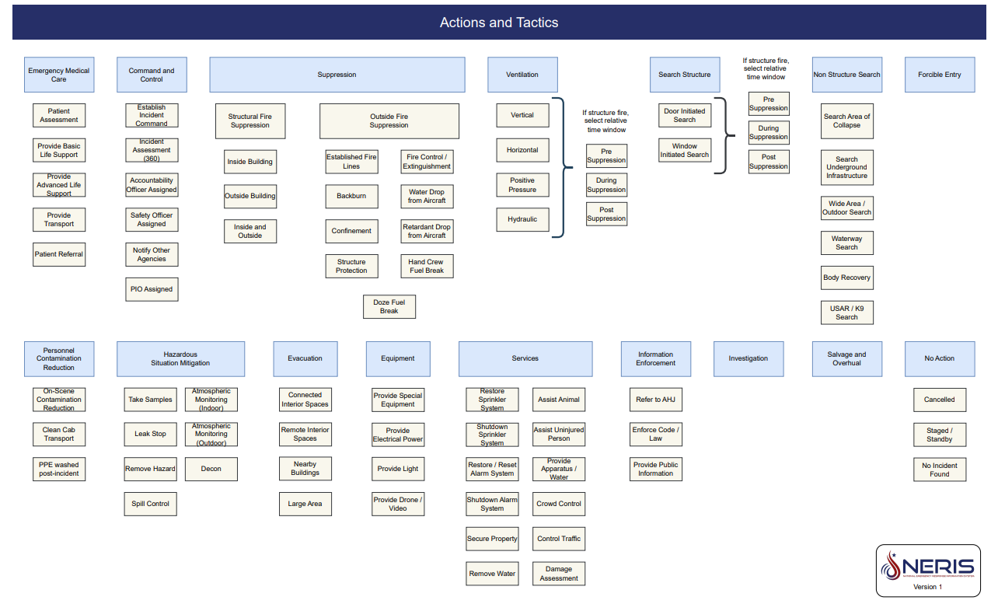

Slide 9
UPDATES EMERGING HAZARDS AND STRUCTURE EXPOSURES
1.
Emerging Hazards
This module will allow the system to adapt to the dynamic environments in which we operate, facilitating the collection of data on emerging threats.
2.
Structure Exposures
This straightforward addition to the original incident report simplifies data entry, even in complex situations such as urban fires and the wildland-urban interface. By implementing this change, we will decrease report completion time and enhance accuracy during intricate fire incidents.

Slide 10

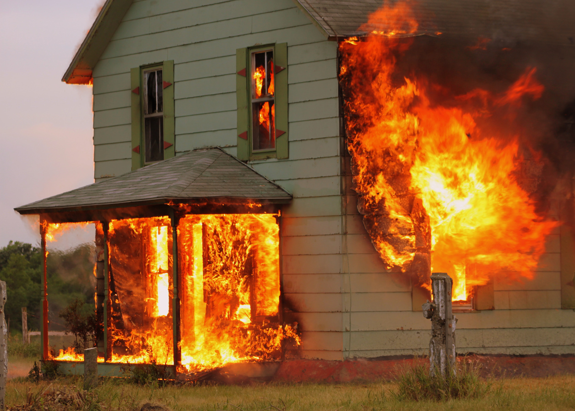


NERIS INCIDENT TYPES
NERIS Incident Type Codes are organized into broad categories and further split into more specific groups. Notably, Fire incidents are prioritized, with distinctions made between inside and outside occurrences. Similarly, Medical incidents hold equal significance, classified into Trauma and Illness.
UNDERSTANDING INCIDENT TYPES
Incident Types begin with a Primary Type, which is then divided into Sub-Groups, ultimately leading to specific Incident Types.
Primary Category >>>>>>> Sub-Group Category >>>>>>>> Incident Type
Fire - Inside (Structure) - Room and Contents
Medical - Illness - Altered Mental State
Hazardous Situation - Hazard Non-Chemical - Bomb threat/ Suspicious Package
Breakdown of Incident types followed

Slide 11
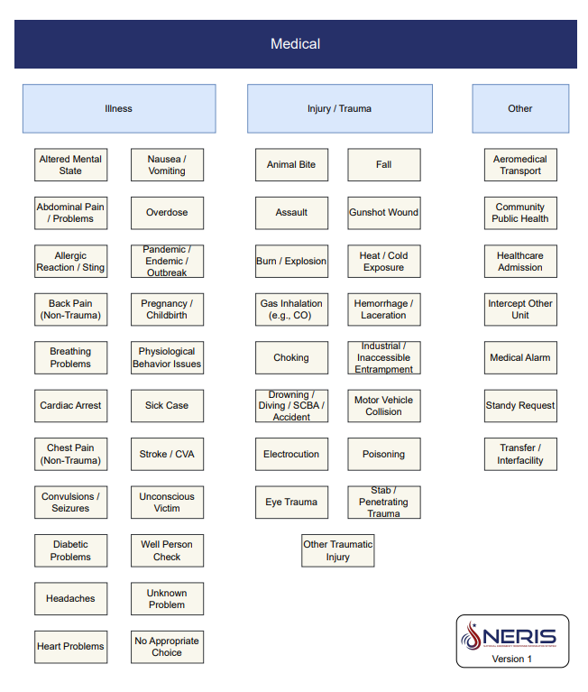

Slide 12
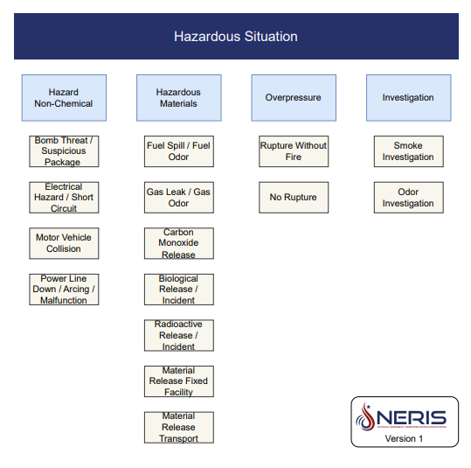

Slide 13
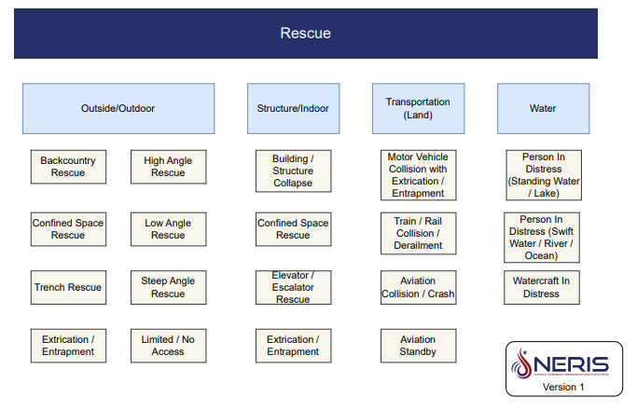

Slide 14
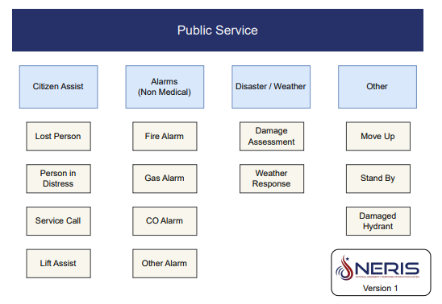

Slide 15
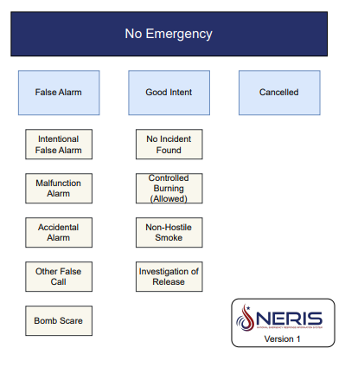

Slide 16




If you are unable to locate the precise incident type, please select the option that most closely aligns with your situation. You can provide further details under Action Type, Location Use, or Medical sections.

Slide 17
GEORGIA NERIS FORM

Slide 18
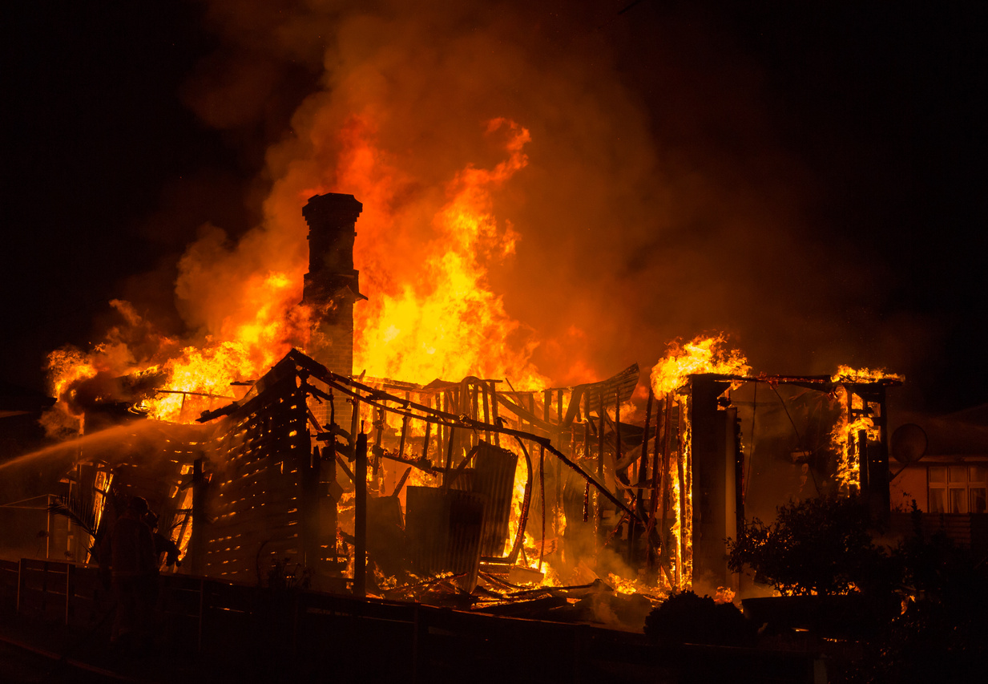
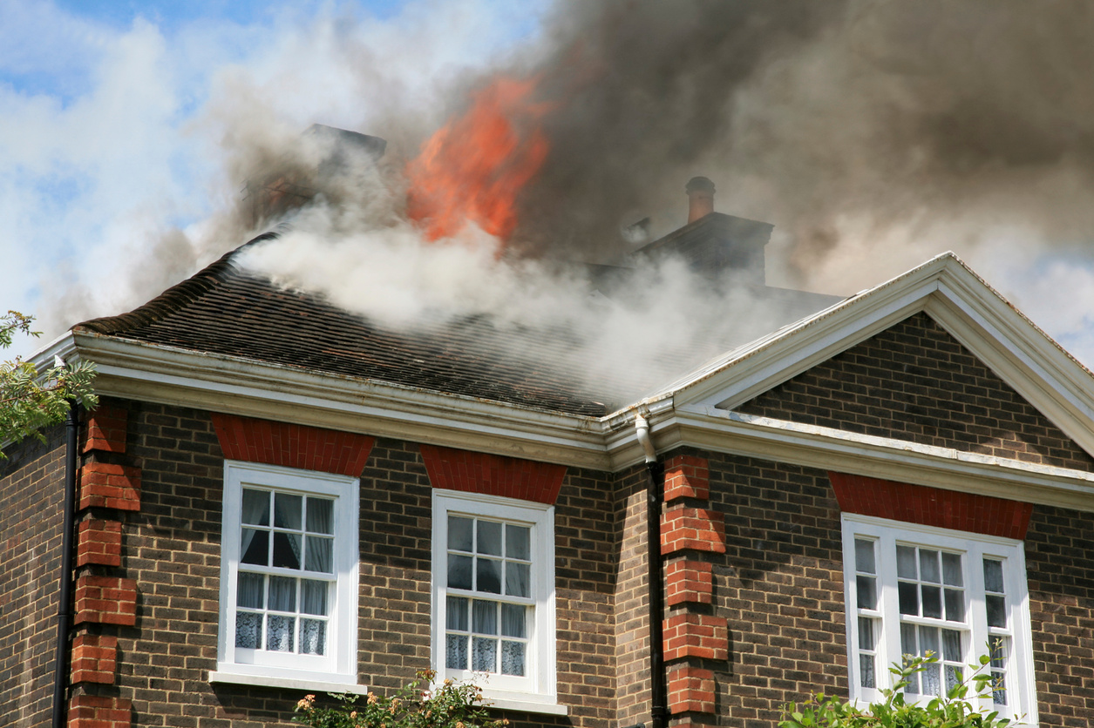
INCIDENT TAB
Incident Details
  NERIS Incident ID
  Incident Number
  Additional Incident Types
  Primary Station - For area of Incident
  Shift or Platoon
  Alarm
  Response Mode to Scene
  Fire Firefighter Injuries
  Non-Firefighter Injuries
  Firefighter Deaths
  Non-Firefighter Deaths
  People Present at time of Incident:
  Number of People Displaced
  Displaced Cause
  Animal Rescue Count

Slide 19


INCIDENT TAB
Timestamps
  Alarm Date Time
  First Arriving Unit Date Time
  Command Established Time
  Sizeup Completed Time
  Primary Search Begin Time
  Primary Search Complete Time
  In Service Date Time
  Incident Clear Time

Slide 20

INCIDENT TAB
Location
  Incident Address
  Zone Number
  District
  Location Type
  Street Number Prefix
  Street Number
  Street Number Suffix
  Distance/Mile Marker
  Street Prefix Direction
  Street Prefix
  Street Prefix Modifier
  Street Preposition Type Separator
  Street Name
  Street Postfix
  Street Postfix Modifier
  Street Postfix Direction
  Direction of Travel
  Unit Value (Number/Letter)
  Unit Type
  Favorite Postal Code
  Postal Code
  City
  State
  County
  United States
  Incident GPS Coordinates
  Cross Street
  Place Type
    Structure
    Site
    Subsite
    Wing
    Floor
    Room
    Section
    Row
    Seat
    Marker
    Neighborhood
  Unincorporated Community
  Incorporated Municipality

Slide 21

INCIDENT TAB
Property Use
Authorization
  Property Use Type
  Property In Use
  Property Secondary Use
  Member Making Report - Signature
  Officer in Charge - Signature
Actions
Narratives
  Action Type
  Actions Taken
  Primary Narrative
  Obstacles Narrative
  Additional Narrative
Aid Given/Received
  Add Given
  Non-Fire Department Aid

Slide 22

APPARATUS/PERSONNEL
Unit Responses Details
Medical
  Unit Personnel County
  Unit Personnel
  Unit Actions Taken
  Unit Response Starting GPS Coordinates
  Unable to Dispatch
  Dispatch Time
  Enroute to Scene Time
  Canceled Enroute Time
  Staging Time
  On Scene Time
  In Services Date Time
  Clear Time
  Response Mode:
  At Patient Time
  Transfer Patient Care to Agency Time
  Enroute to Hospital Time
  Arrived at Hospital Time
  Transfer of Patient Care to Facility Time
  Hospital Clear Time
  Destination
  Unit Narrative

Slide 23
EMERGING HAZARDS
Electric Hazards
Power Generation Hardware Hazards
  Electric Hazards
    Electric Hazard Type
    Source or Target
  State Additions
    Was the battery fire responsible for any injury or death to non-emergency personnel?
    If so, what led to the non-emergency personnel injury or fatality?
    Was the battery fire responsible for any injury or death to Emergency Personnel?
    If so, what led to the emergency personnel injury or fatality?
  Wind Turbine
  Photovoltaics
    Photovoltaics Type
    Source or Target
  Other
  None
  Not Applicable

Slide 24
DISPATCH TAB
Dispatch Tab will be only used for Departments with CAD Integration
Dispatch Details
  Dispatch Center ID
  Dispatch Incident Number
  Dispatch Determinant
  Dispatch Incident Code
  Dispatch Disposition
  Dispatch Automatic Alarm
  Dispatch Shifts or Platoon
  CAD Comments
    Comment Time Stamp
    Comments

Slide 25
CONDITIONAL TABS
Fire Tab
Incident Vehicle Information
  Fire Primarily Occurred
  Water Supply
  Suppression Appliance
  Fire Investigation Needed
  Vehicle License Plate
  Vehicle Year
  Vehicle Make
  Vehicle Model
Can add up to three
Structural Fire
Outside Fire
  Fire Progression Evident
  Fire Arrival Condition
  Fire Floor of Origin
  Fire Room of Origin
  Fire Damage Type
  Structure Fire Cause
  Fire Acres Burned
  Outside Fire Cause

Slide 26
CONDITIONAL TABS
Fire Exposures
Medical
  Exposures
    Exposure Type
    Exposure Damage
    Exposure Location Use Type
    Exposure Location in Use
    Location Secondary Use
    Same as Location Information requested
  Patients
    Patient Care Report
    Provider Impression/Assessment
    Patient Status
    Transport Disposition
    Pre-Arrival Cardiac Arrest
    Cardiac Arrest
    Initial Level of Provider
    Highest Level of Care Provided on Scene
      Patient Body Injuries
        Injury Type
        Body Site of Injury
    Procedures Used
    Patient Human Factors Contributing to Injury
    Safety Equipment Used or Deployed by Patient

Slide 27
ENHANCEMENTS TO AID IN COMPLETING THE FORM
These elements will be included in the incident form to aid in its completion.
Key Components for Incident Reporting
  Incident Details
    NFIRS to NERIS Incident Type Breakdown
  Incident Location & Unit Response
    GPS Location Tool: Aids in determining Latitude and Longitude
      Please note that this website is not purchased or supported by the State of Georgia or Image Trend Elite; it is merely an option you can utilize.

Slide 28

WHAT YOU WILL RECEIVE
  Georgia Fire Incident Reporting Guide
  NFIRS - NERIS Training Power Point
  Georgia Fire Incident Report Scheme
  Georgia NFIRS Incident Type - Georgia NERIS Incident Type
    This is also found under incident types in the form

Slide 29

TO COME
UPDATES/ADDITIONS
We will continue to release updates leading up to January 1, 2026, such as Status Type updates and Process.
For questions please email - safetyed@oci.ga.gov

Slide 30
FROM IMAGETREND ELITE 2026
UPDATES/ADDITIONS
  Existing NFIRS CQI workflows will be replicated for NERIS Fire CQI.
  NERIS secondary schemas to account for the multiple NERIS phases.
  A new feature called concurrent worksheet entry will be released that allows users to enter multiple worksheets to one incident in a single step.
  Supplemental questions will be available in select NERIS grids.
  A fire-only, standalone Field capability will be added for NERIS incidents.

Slide 31


THANK YOU
INFORMATION WILL CONTIUNE TO BE PROVIDED LEADING UP TO JANUARY 1, 2026
safetyed@oci.ga.gov
www.oci.georgia.gov

