Slide 1
Step-by-Step Guide to Create File in Image Trend Elite to upload reports to NFIRS

Slide 2
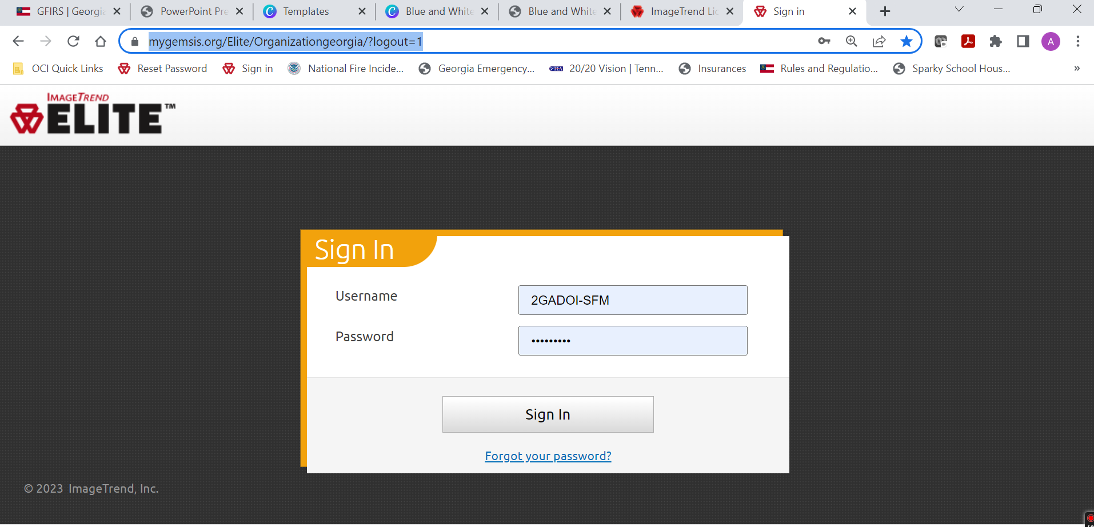
1. Login to Image Trend
Link

Slide 3
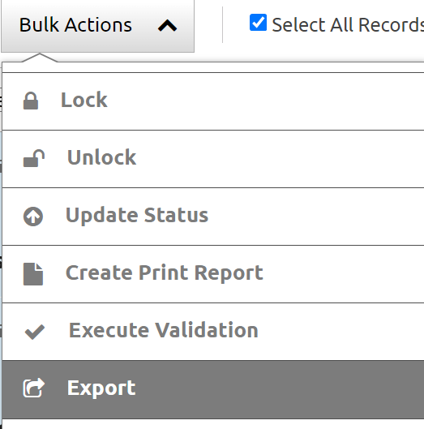
2. In Elite Pull data needed to upload
Go to incidents
Go to view existing
Select dates
Select box for select all records
Select bulk actions and export

Slide 4
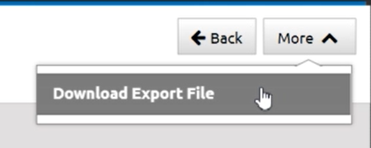
2. Elite Continued.
1. Select OK for Pick an Export (NFIRS (5.0))
2. Wait until screen shows complete
3. Select more and download export file (File will be saved to your downloads)

Slide 5
More information will be coming soon. For Questions please call:
Amanda Jones Fire and Life Safety Educator Supervisor of Reporting Office of Commissioner John F. King C: 470.725.5722 ajones@oci.ga.gov

